Slide 1
Introduction to Recursion
Donald J. Santos, March 2018

Slide 2
What is recursion?
A Method That Invokes Itself
Invokes Itself With Altered Parameter Values
Includes Logic for a Base Case
Avoids Stack Overflows

Slide 3
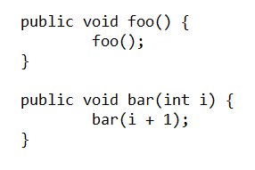
Stack Overflow
*There is no exact number for maximum stack size. It is based on a variety of hardware and software factors. In general, you can expect the potential for a Stack Oveflow if you are recursing several thousand times.

Slide 4
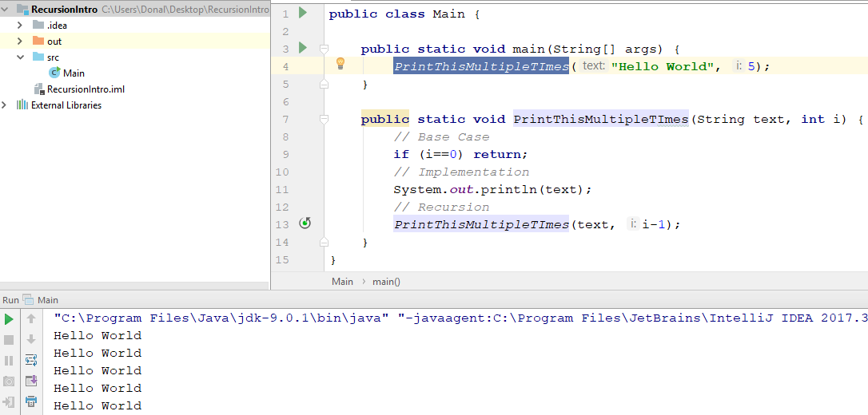
Simple Recursion

Slide 5
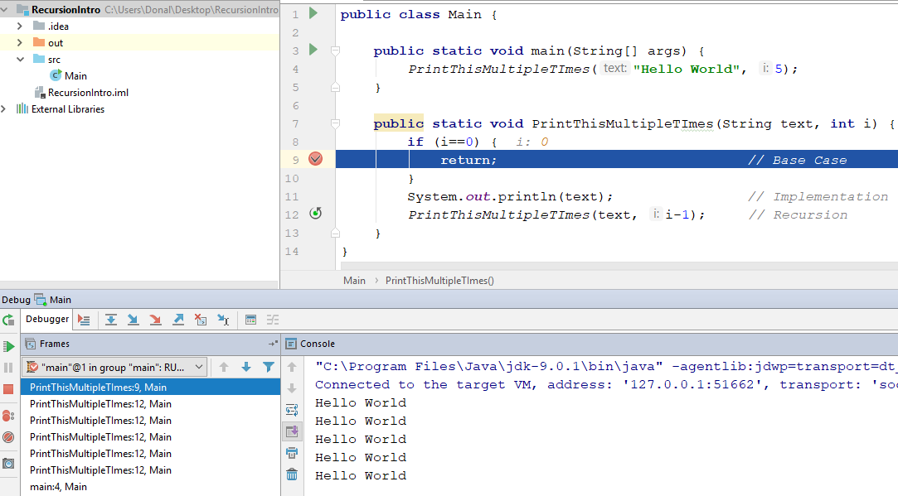
The Stack and the base case

Slide 6
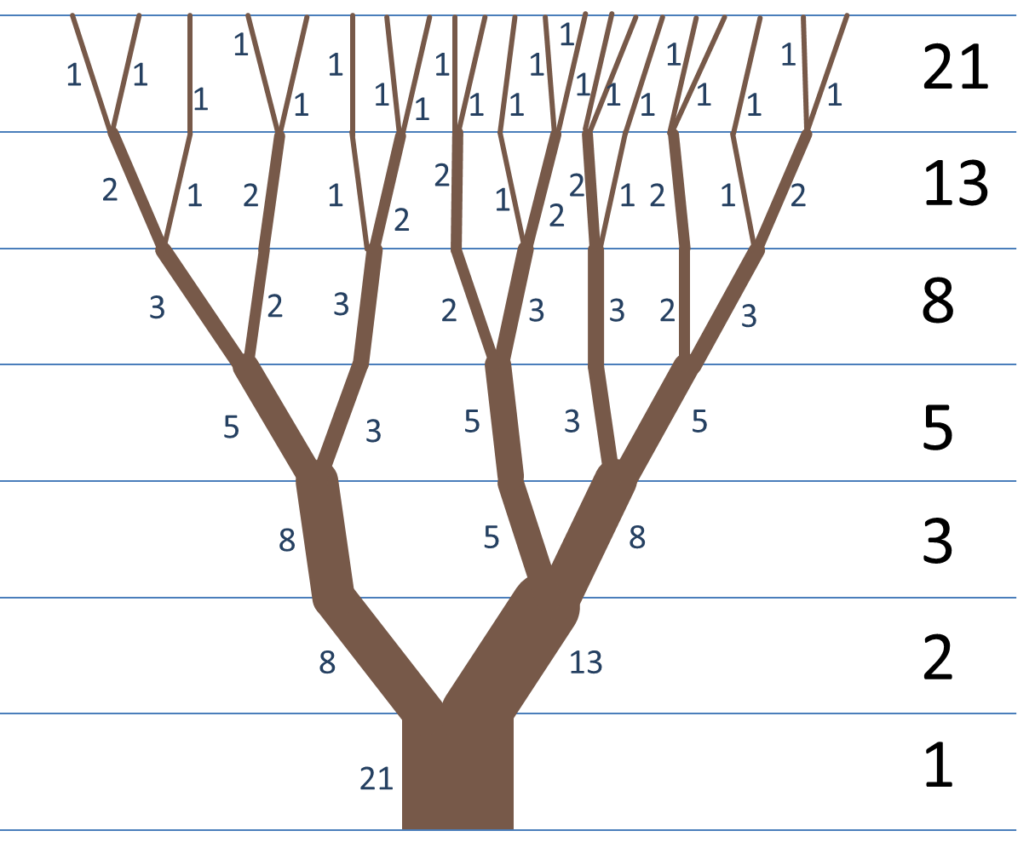
The Fibonacci Sequence

Slide 7
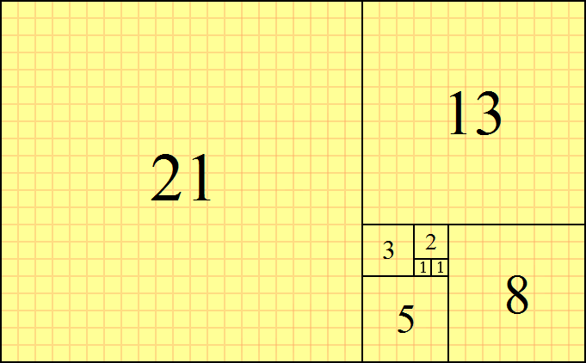
Fibonacci 2-Dimensional Pattern

Slide 8
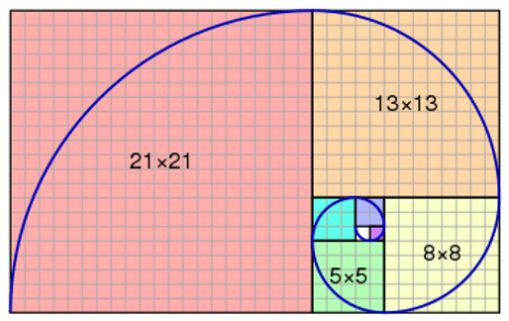
Fibonacci 2-Dimensional Pattern

Slide 9
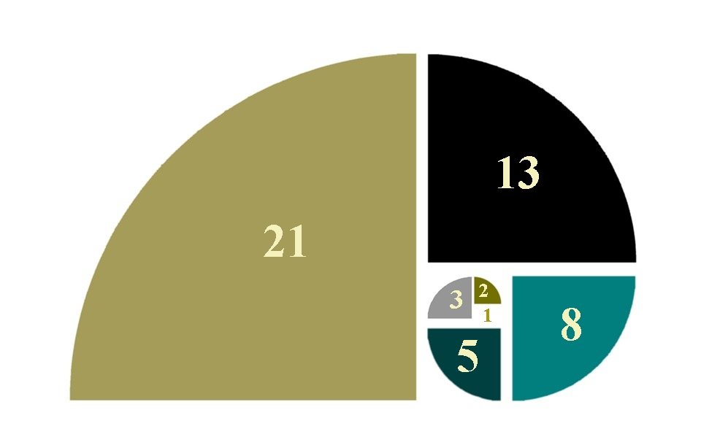
Fibonacci 2-Dimensional Pattern

Slide 10

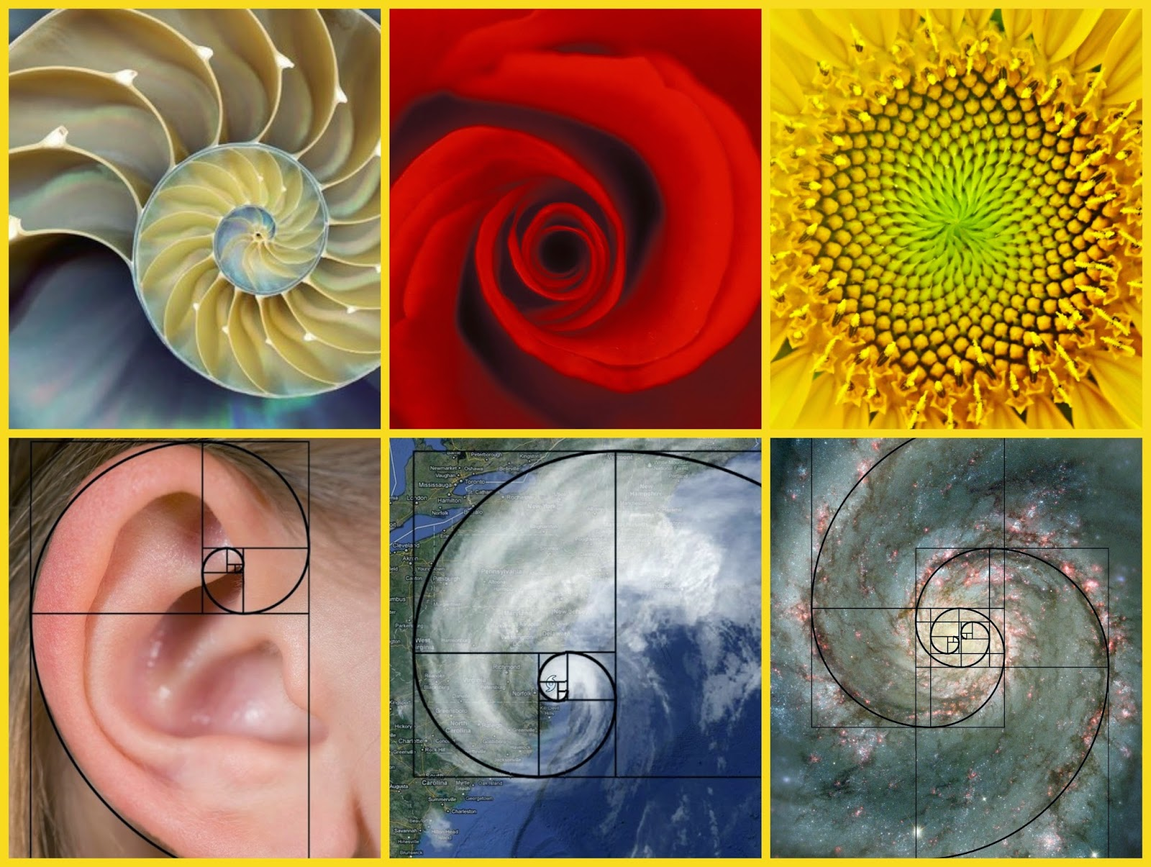
Fibonacci Manifestations in nature
Multicellular Organisms
Atmospheric Dynamics
Cosmological Expansion
Anything That Grows

Slide 11
Single CaseS
F(3) = 3
F(4) = 5
F(5) = 8
F(6) = 13
F(7) = 21

Slide 12
General Case
F( i ) = F( i-1 ) + F( i-2 )

Slide 13
BASE CaseS
F(1) = 1
F(2) = 2

Slide 14
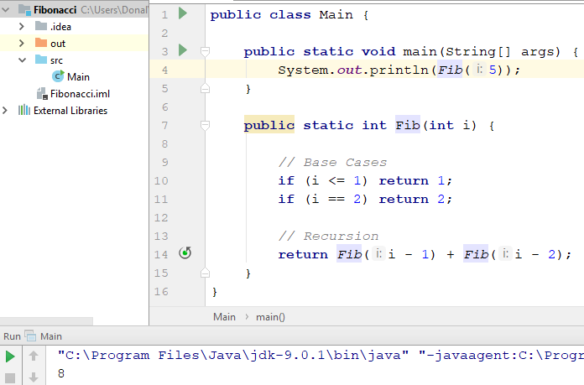
Implementing Fibonacci Algorithm

Slide 15
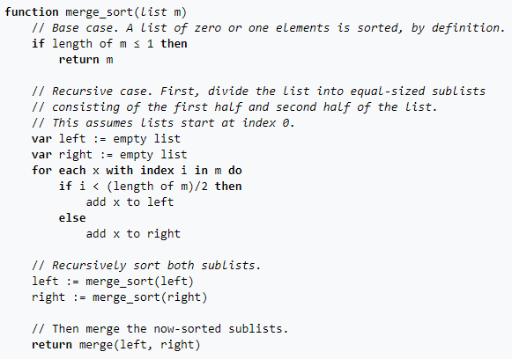
Implementing Fibonacci Algorithm

Slide 16
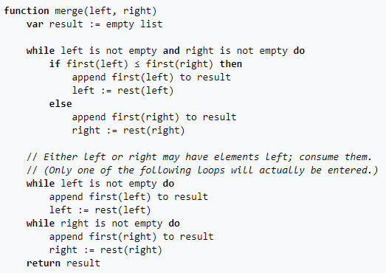
Implementing Fibonacci Algorithm

Slide 17


اتمنى ان اراك فيما بعد
( See You Later! )
github.com/donniesantos

